Slide 1





RuxaiLab
Sentiment Analysis for
Usability Tests
GSoC 2024
Meet #5: Integration to RuxaiLab
Presented By: Olivia Wilson
12-08-2024 21:00 (UTC+3)

Slide 2

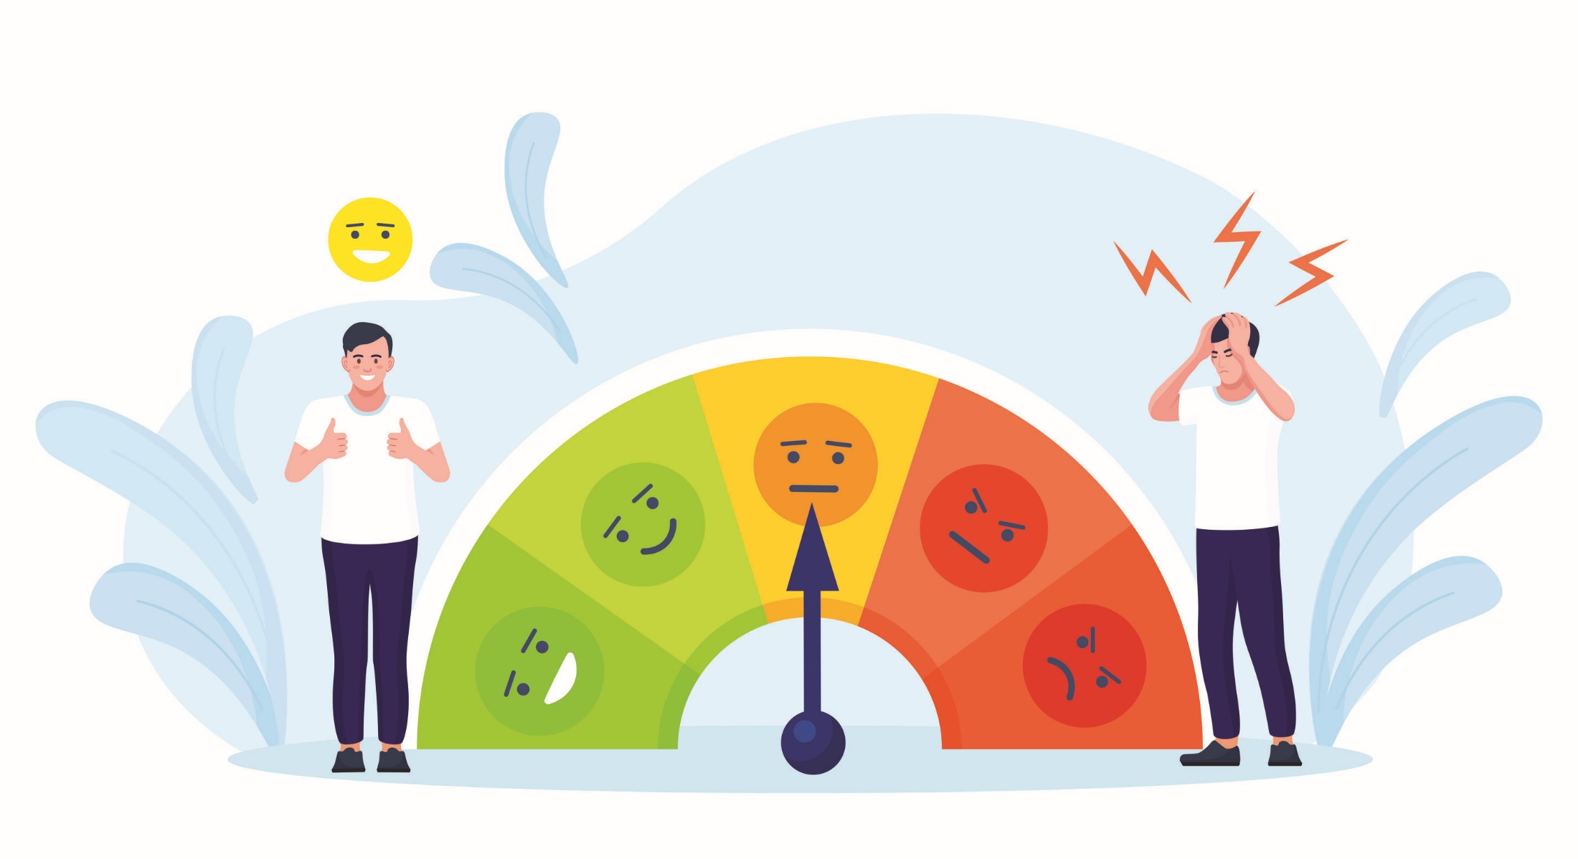
Agenda
Studied Material
Modifications to the APIs
Wave Surfer
Firestore Issue
RuxaiLab and API Integration
FireBase
Coding & Wikki Docs
Timeline & New Tasks
Questions To Mentors
Feedback

Slide 3





Studied Material
VueJS:
VueJs Crash Course [link]
Vuetify:
Vuetify V3 PlayList By Ninja [link]
Vuetify V2 Project Coding [link]
Vuetify V2 Documentation [link]
Wikki for This Resource is available in the Repo [link]

Slide 4

Modifications to the API
Added start and end time to the body (in sec)
Added Stage to download the video from the URL(Fire store)
Extract Region required
Apply Inference only to this Segment
The API Function is available here

Slide 5
Modifications to the API
Input:
url
start_time
end_time
whisper_model_size
Output:
utterances_sentiment ⇒ Array for the utterances in this time stamp :D
We can Enhance Later no problem (Versioning)

Slide 6
Modifications to the API
Some Versions that can be used Later:
Another Versions are available for pre splitting the Audio into segments
⇒ The user just choose the required segment
API for splitting audio according to Silence
Check code here

Slide 7
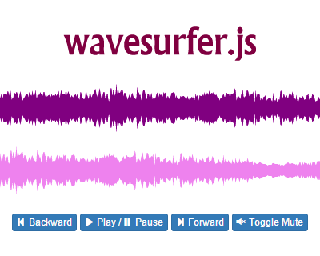

WaveSurfer
Native Javascript
No Vue Dependency Issues
Full Control
Library Documentation here

Slide 8
WaveSurfer
Region Plugin for Marking TimeStamps
Plugin Documentation here

Slide 9


Firestore Issue
FireBase CROS is configured correctly
No problem for accessing Firebase :D

Slide 10
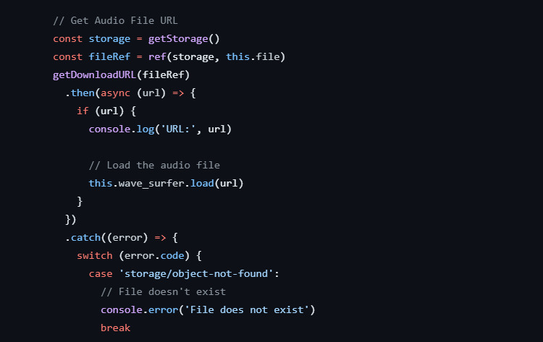

Firestore Issue
Wavesurfer makes a request to download the file from firestore
This is an HTTP Request

Slide 11

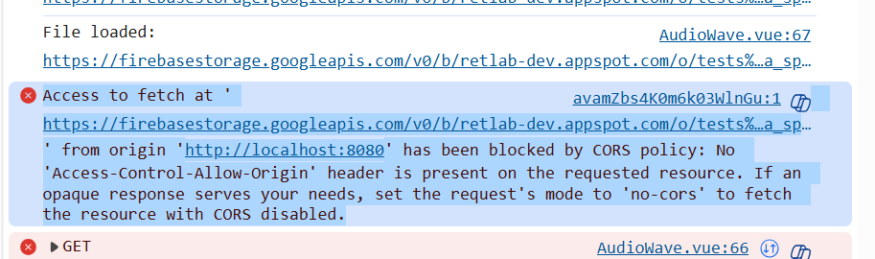
Firestore Issue
We got CROS error
This is an HTTP Request

Slide 12


Firestore Issue
Just Google the error <3

Slide 13
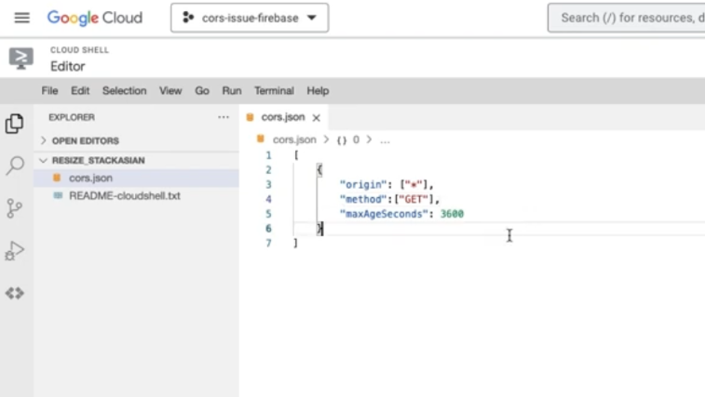
Firestore Issue
The video here fixes that issue
Just add the Credentials Origin to the CORS for firestore

Slide 14

Firestore Issue
Now We can HTTP request the fire store easily

Slide 15


RuxaiLab and API Integration
Trying to Remember the API Code :D
Need Axois to call the Flask App APIs

Slide 16
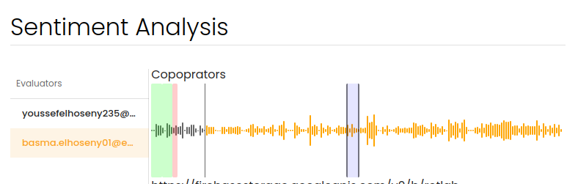
RuxaiLab and API Integration
We have several answers per Test
User need to select the segment
Start
End

Slide 17
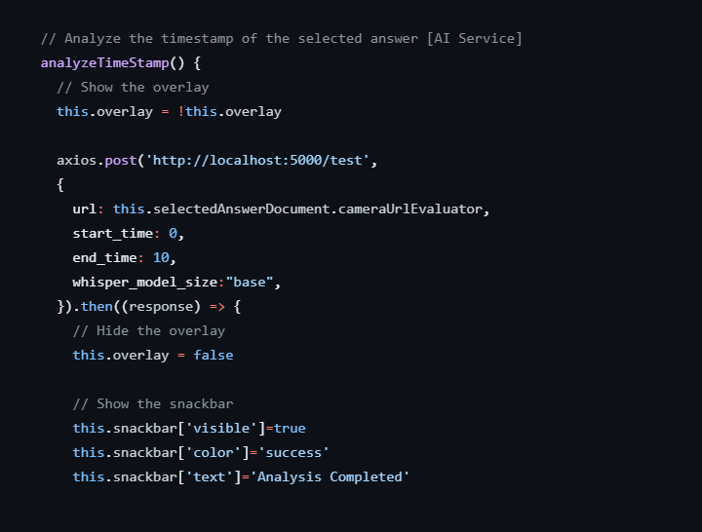
RuxaiLab and API Integration
Let’s Call The API from RuxAiLab
Fire Store URL

Slide 18

RuxaiLab and API Integration
We have 2 Options to Send Segment to BackEnd :
Send URL and Clip in BE
Send only the Segment
Result:
It depends on the use Case
Sending Segment will causes a lot of traffic
For Simplicity as V1 we send the URL only and split happens i the backend

Slide 19
RuxaiLab and API Integration
Now we take the response from the API
Format :
Array of Utterances in the segment sent
Each Utterance:
Start
End
Transcript
Sentiment
Score

Slide 20
RuxaiLab and API Integration
Now we take the response from the API
How to show that :
Each Utterance as a Region in the Audio
Segment from 0-10s have 3 utterances ( 2POS - 1NEG)

Slide 21
Firebase
RuxAiLab Connects to the API Successfully
But we need to Save this Responses
We need to connect to firebase <3

Slide 22
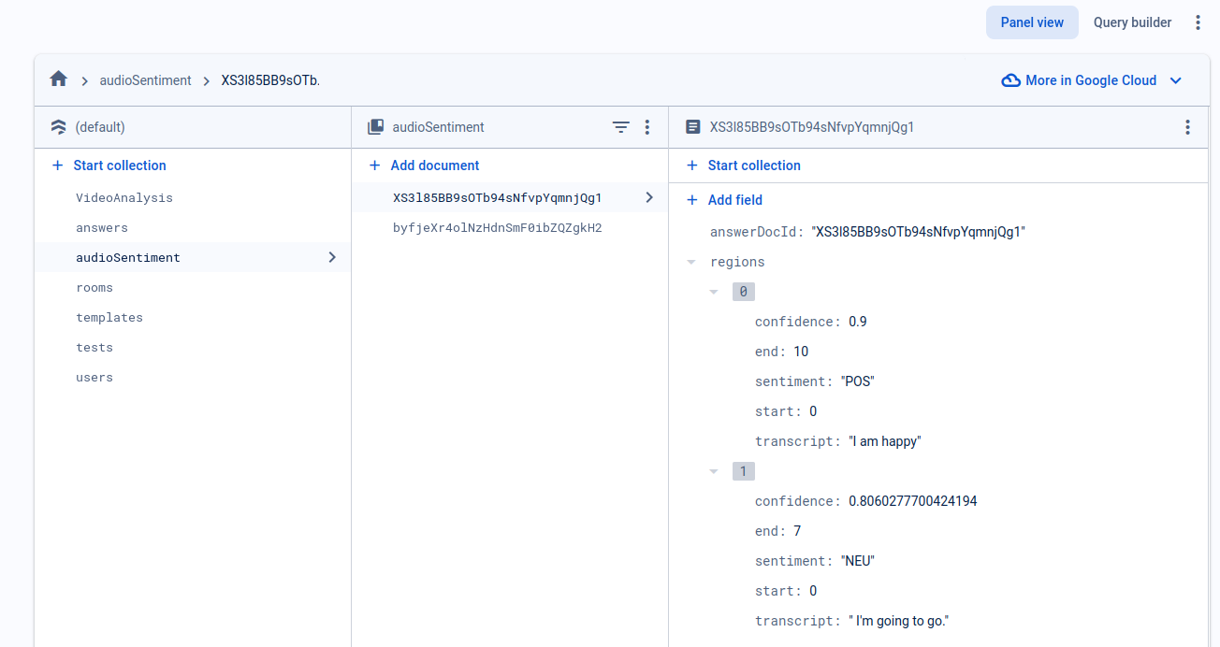
Firebase
We will Create a separate collection for the audio Sentiment for each answer
Model file is @ src/models/AudioSentiment.js
Notes:
User FireBase -> UID
ANswerDOcID
UserDOcID

Slide 23
Firebase
Model Structure :
answerDocId [ID related to the audio answer]
regions [array]
start
end
transcript
sentiment
score
Document id is set to be the answerDocId

Slide 24
Firebase
Now We have the previous results saved :D
Later, We will need an idea to Handle overlaps

Slide 25

Coding
Files (RuxAiLab):
View:
SentimentAnalysisView.vue
Organisms
UserModeratedSentiment.vue
Molecules:
AudioWave.vue
Check More Files [here]

Slide 26
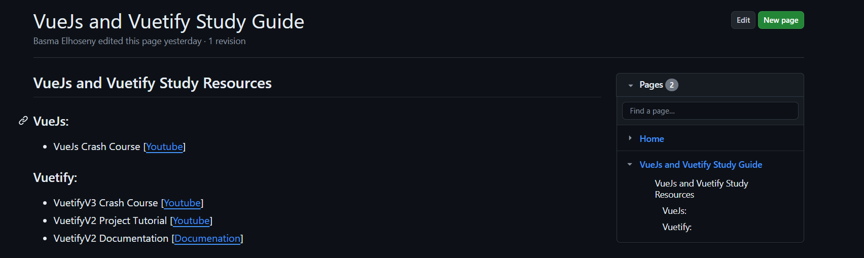
Wikki (Vue and Vuetify Learning Resources)

Slide 27

New Tasks
New Tasks:
Transcript Section
Add Time to the timeline
Delete Region
Cooperators Part
API Docs
Read Me for BE
Refactor for BE
Check Docker Image
Check Deployment [Can be postponed]
Async Requests (Very Later)
Do you see any tasks ?!

Slide 28

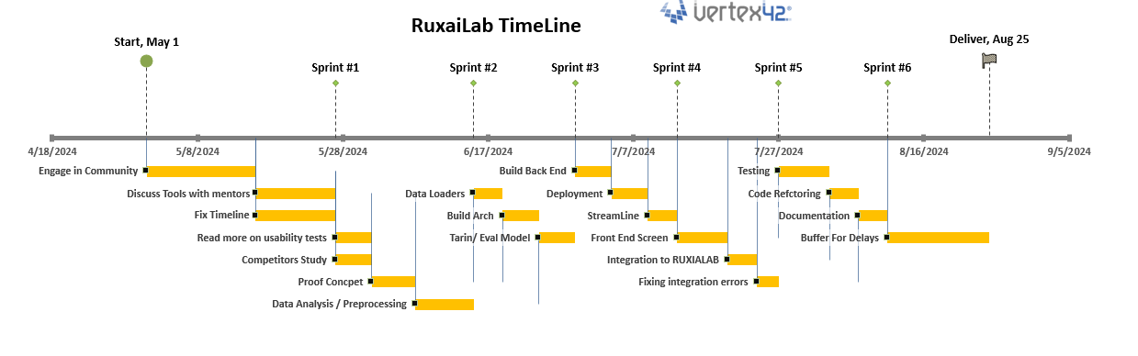
Timeline
So Far, We are back to Timeline

Slide 29
Timeline
Task | Day
Transcription Section | Monday
Delete Region | Tuesday
Cooperators Section | Wednesday
Add Time to Timeline | Thursday
Buffer | Friday
Follow Up Meet | Saturday
Refactor BE (Small Part) | Saturday
API Documentation | Saturday
BE ReadMe | Sunday
Check Docker Image | Sunday

Slide 30

Questions To Mentors
I think we need to have another meet next week for follow up (Sat)
Do you see Another Tasks
Regarding the final submission what is expected to be prepared
Do we need to show other mentors our progress before submission
We need to stop coding at Sunday and make sure to finish documentation then we can continue coding
Can we submit the project without API Deployment ( To be checked later → But we have an already running Image)
PRs
What about other contributors asking on Discord

Slide 31


Feedback
Give me your Feedback about progress till now &
Next Steps
Small notes = Great Work

Slide 32





Thank you
Any Questions?
BasmaElhoseny01
basmaelhoseny01
basmaelhoseny6@gmail.com

